Slide 1
Team Meeting Focus: Writing & Rubrics
October 1^{st,} 2015

Slide 2
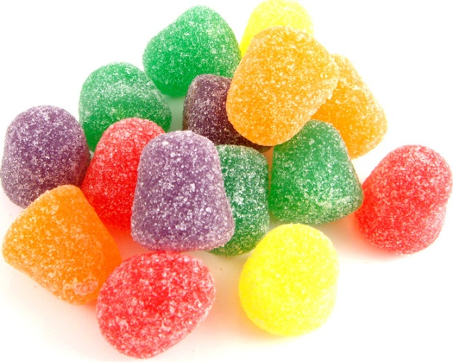
Group Activity
Using gumdrops and toothpicks, build a house that represents every member of the group's dream home. Be sure to work together cooperatively
Notes:
Break into groups of 3-4 teachers
Provide teams with 10(??) minutes to create their homes
Provide 1-2 minutes for groups to view everyone’s creations
Ask- how do you think you did- on a scale of 1-4, what would you rate your final product?

Slide 3
How did you do?
Use the rubric to evaluate your dream house
 | 1 | 2 | 3 | 4
Geometric Shapes | Uses three basic shapes | Uses four basic shapes | Uses five basic shapes | Uses five basic shapes and includes examples of symmetry
Details of House | Shows outside walls only | Shows outside walls and rooms only | Shows outside walls, roof, and inside walls | Shows walls, roof, rooms, inside & and outside features
Structure | Part of structure falls when shaken | Structure stands when shaken, but wobbles | Structure stands properly when shaken | Structure stands when shaken and shows laws of physics
Artistic Impression | Some color pattern evident | Color pattern evident on inside or outside of structure | Full use of color patterns inside and outside of structure | Full use of color patterns inside and outside of structure in complementary colors from color wheels
Notes:
Introduce rubric
Have groups evaluate their product using the rubric
Share out final scores
Discuss- did you do better or worse than expected? Why? How would your final product have been different if you were given this rubric before constructing your home?

Slide 4
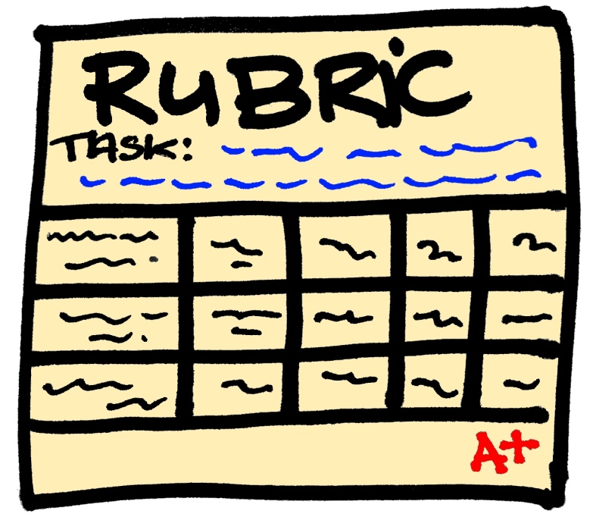
Why Rubrics?
Drives instruction
Clearly articulated expectations
Students can take responsibility for learning
Consistency in scoring
Notes:
Brief overview of why rubrics are important and how we can use them to drive instruction.
Link to mentor text PD from last year

Slide 5
Short Response Questions (2 pts.)
Why is the setting of “The Cave of the Oilbird” important? Use two details from the story to support your response (RL.4.3)
A reason the setting of ‘The Cave of the Oilbird” is important is because the words that Manuelo said, “If you hurry in the rainforest, you could miss something very interesting and very beautiful.” makes sense. One other reason is that you could get lost in the rain forest very easily.
The setting of ‘The Cave of the Oilbird” is important is because it explains the amount of birds that live in habitat. For example, it says, “then more heads appear around the eyes.” Another example is when Carla thinks to herself, “There must be hundreds of them staring at me.”
The setting of “The Cave of the Oilbird” is important because the author wanted us to see a picture in our mind while informing us the oilbird is also extinct.
How would you score these responses?
Notes:
Review sample question from 2014 state test
Read through each sample response- have teachers evaluate the responses (0, 1, or 2) and briefly explain why

Slide 6
2- Point Short Response Rubric
Score | Response Feature
2 Point | Valid inferences and/or claims from the text where required by the prompt Evidence of analysis of the text where required by the prompt Relevant facts, definitions, concrete details, and/or other information from the text to develop response according to the requirements of the prompt Sufficient number of facts, definitions, concrete details, and/or other information from the text as required by the prompt Complete sentences where errors do not impact readability
1 Point | A mostly literal recounting of events or details from the text as required by the prompt Some relevant facts, definitions, concrete details, and/or other information from the text to develop response according to the requirements of the prompt Incomplete sentences or bullets
0 Point | A response that does not address any of the requirements of the prompt or is totally inaccurate No response (blank answer) A response that is not written in English A response that is unintelligible or indecipherable
Notes:
Pass out copies of 2 pt rubric. Review critical features for each score (emphasize claim/inference)

Slide 7
Let’s Take a Second Look
Why is the setting of “The Cave of the Oilbird” important? Use two details from the story to support your response ( RL.4.3)
SCORE: 1 Point
A reason the setting of ‘The Cave of the Oilbird” is important is because the words that Manuelo said, “If you hurry in the rainforest, you could miss something very interesting and very beautiful.” makes sense. One other reason is that you could get lost in the rain forest very easily.
Detail # 2
Detail # 1
Notes:
Have teachers keep their copies of the rubrics out.
Re-evaluate the responses using the rubric and point out why students lost points

Slide 8
Let’s Take a Second Look
Why is the setting of “The Cave of the Oilbird” important?
Use two details from the story to support your response)
SCORE: 2 Points
The setting of ‘The Cave of the Oilbird” is important is because it explains the amount of birds that live in habitat. For example, it says, “then more heads appear around the eyes.” Another example is when Carla thinks to herself, “There must be hundreds of them staring at me.”
CLAIM
Detail # 1
Detail # 2

Slide 9
Let’s Take a Second Look
Why is the setting of “The Cave of the Oilbird” important? Use two details from the story to support your response)
SCORE: 1 Point
The setting of “The Cave of the Oilbird” is important because the author wanted us to see a picture in our mind while informing us the oilbird is also extinct.
CLAIM

Slide 10
Where do we Start?
Introduce rubrics to your students
Provide students with a rubric before they begin their writing
Share writing samples (at all levels)
Model how to evaluate writing using a rubric
Evaluate student writing as a whole class
Provide students with opportunities to evaluate samples AND their own writing pieces

Slide 11
What’s Next
Think about upcoming ELA lessons/units
How can you begin to incorporate rubrics into your instruction?
What support do you need?

